Slide 1

Chicago crime
A 2001 – 2023 Analysis

Slide 2

Understaning The Data Set
Data set is from kaggle
Almost 8 Million recorded cases
From 2001 to 2023
35 crime classifications

Slide 3
Understaning The Data Set
Actual case files with Information about :
Crime Type
Crime description
Location
Time
Arrest
Span
Domectic Vs Non Domestic

Slide 4

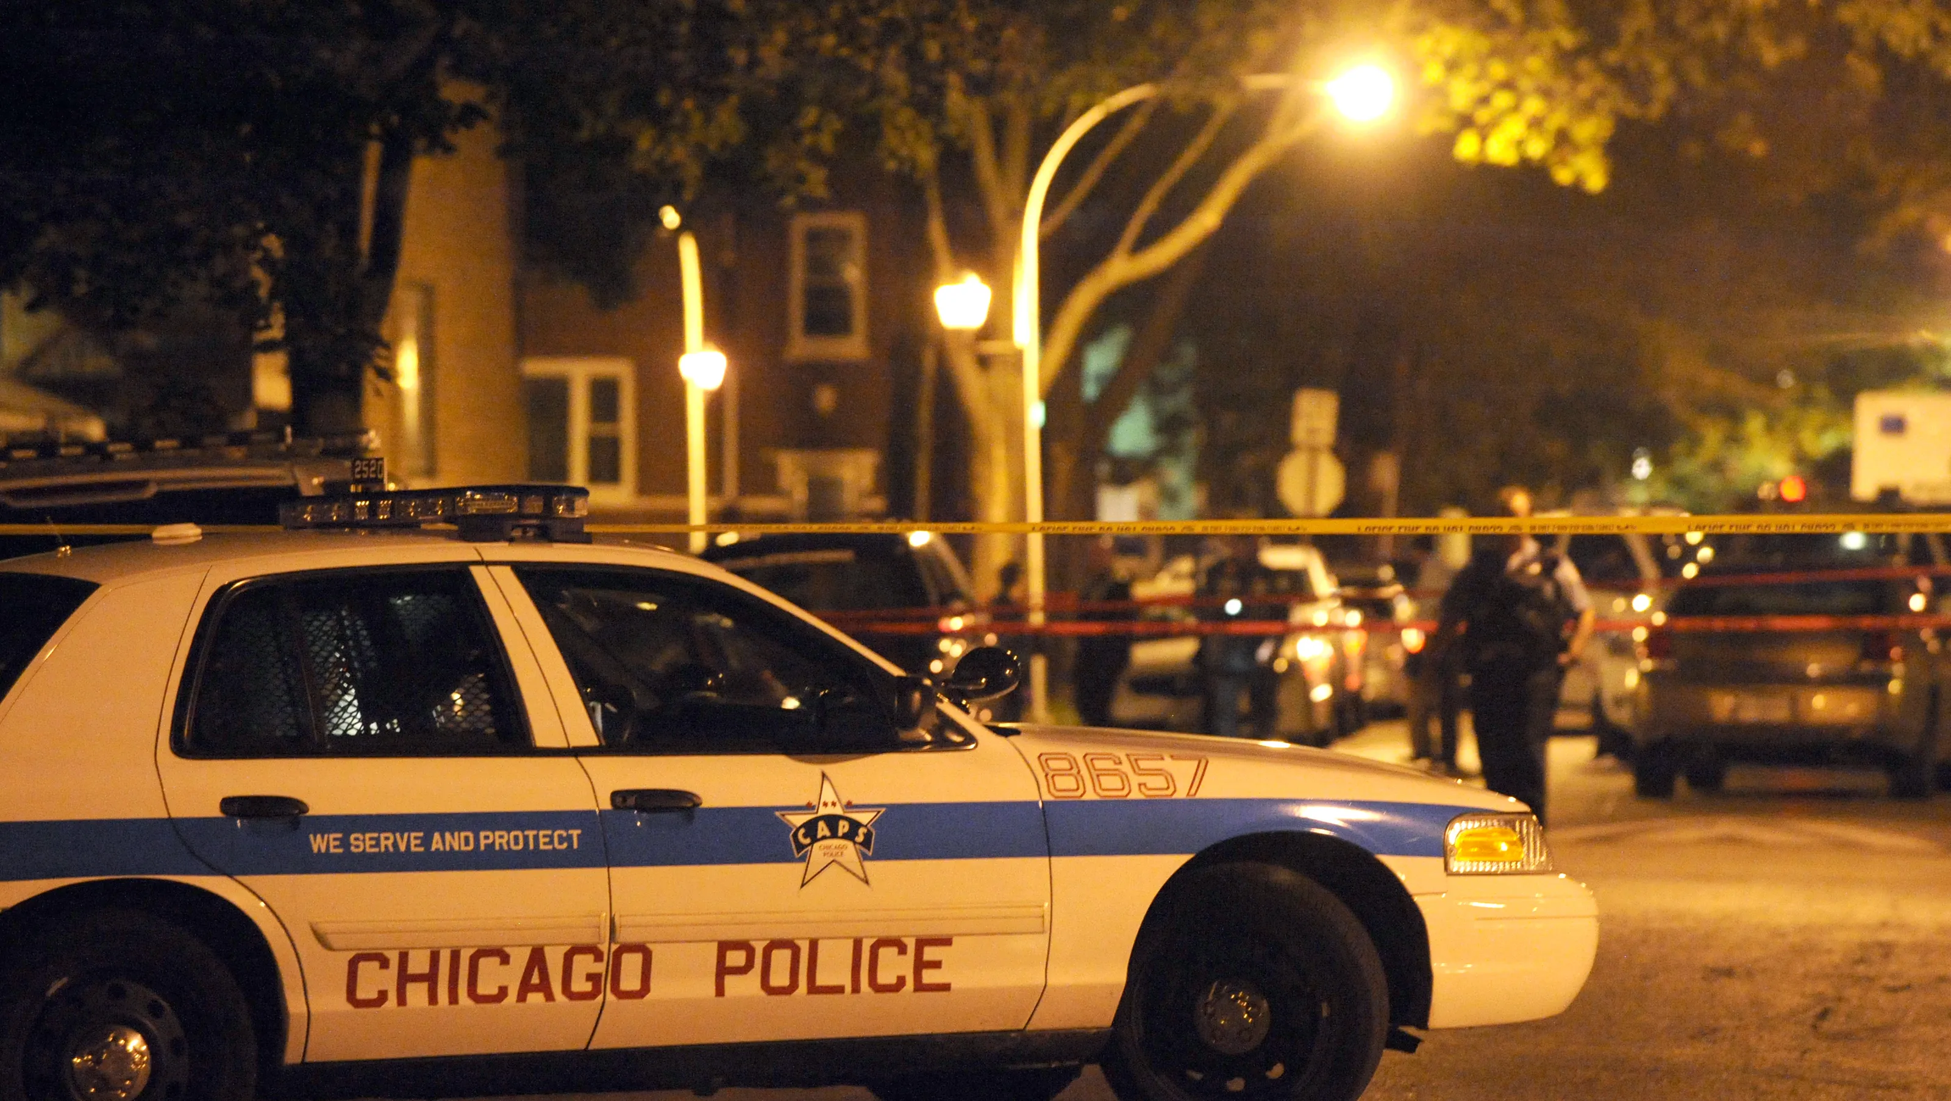
Analysis Paramiters
Over all Macros :
The Most repeated Crimes
Geographic analysis
Safest addresses vs most dangerous
Key Location Safty (Home,In public)
Arrests analysis
location
Crime type
Domestic vs Non Domestc crimes

Slide 5
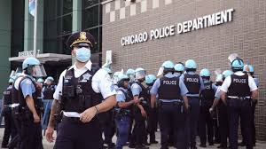
Analysis Paramiters
Time Series Analysis
Crime rates over time (inc. vs. dec.)
Effect of Covid-19 on crime pattern
Cyber crimes vs Violent Crimes
Arrest rates over time (inc. vs. dec.)
Average time for completion
Seasonality
Crime rates over the season
The correlation between heat and violent crimes
Time of Day analysis
Peak Hours for all crimes
Peack hourse for violent crimes: ex. Homicide

Slide 6

Conclosion
Over all Crime rates are Declining
Dometic violence is an issue for Chicago
Ovel all arrest rates are declining
The effect of Covid- 19 on crime patteren is very significant
Home is NOT the safest location
The correlation between heat and violence can be proven in Chicago

Slide 7
Recommendations
The public should avoid these locations
Areas : S STATE ST , S MICHIGAN AVE, S HALSTED ST , W MADISON ST, S DR MARTIN LUTHER KING JR DR
Districts: 8 , 11, 6, 7 & 25
The public should maximize there security during those times
12 pm and 12 am
Chicago Police department needs to make more effort in increasing over all arrest rates
Chicago Police department needs to improve the arrest rates disparity across different crime types and across locations.

Slide 8
Thank you

